Slide 1


2024 Elections, Disinflation & Ai
Steen Jakobsen, Chief Investment Officer
January 16th, 2024

Slide 2

Main Points
Narrative
Disinflation
Fed & ECB will cut rates aggressively
Election Cycle
50% of world going to elections in 2024. Market will be juiced
RISK
Geopolitical risk – Middle East
Everyone is wrong scenario: Deeper recession & China blow-out
Long Term
Marginal Cost of Energy to zero before 2035?
Final Innings of Pretend-and-Extend..but final!

Slide 3
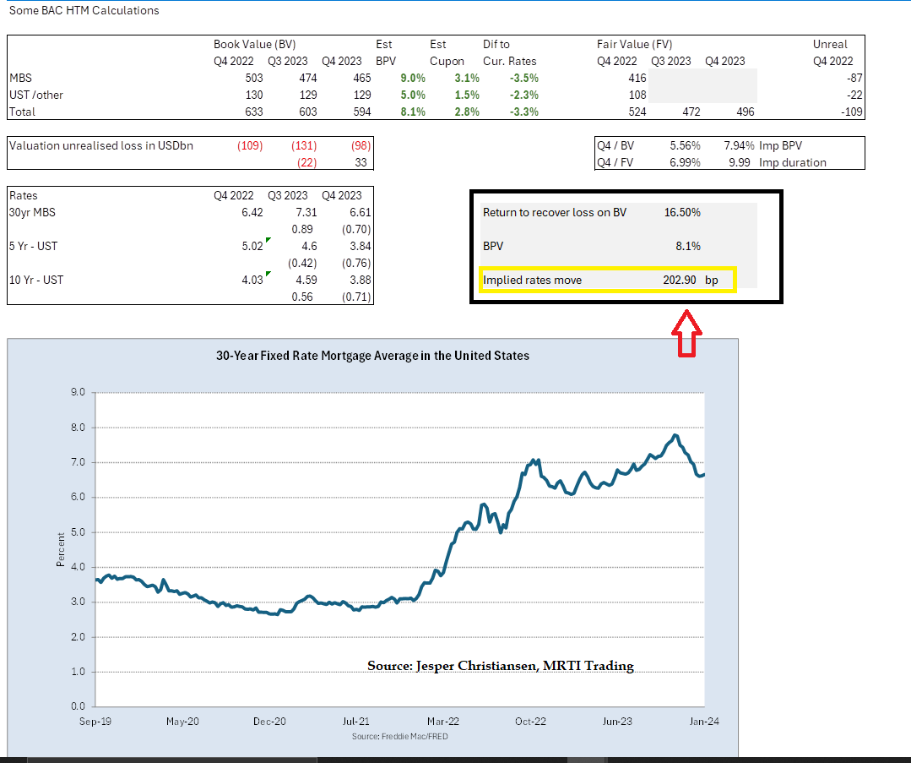
Concept: Rates will go to ZERO loss for BAC on HTM…..
Rates will go to a level which will “neutralize” BAC & small banks from Held-to-Maturity Loss
The below calculation comes up with estimated need for rates to come down 202 BPS in blended US bonds (but roughly same in 10Y) ➔ 10Y @ 225 bps

Slide 4
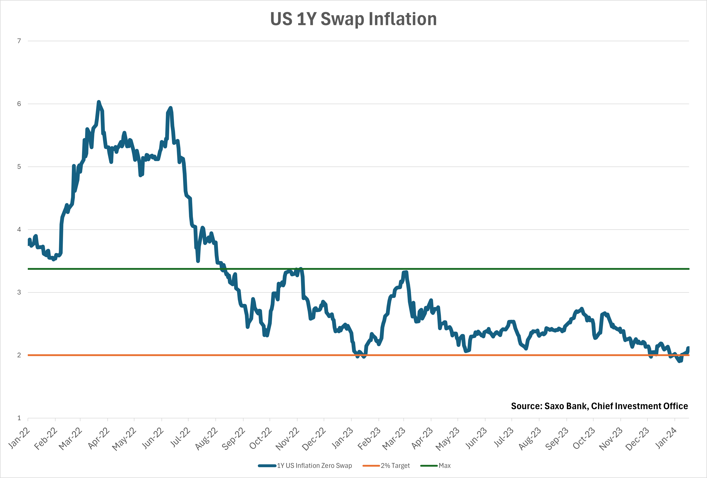
Inflation is trading at 2% 1-y forward already – disinflation

Slide 5
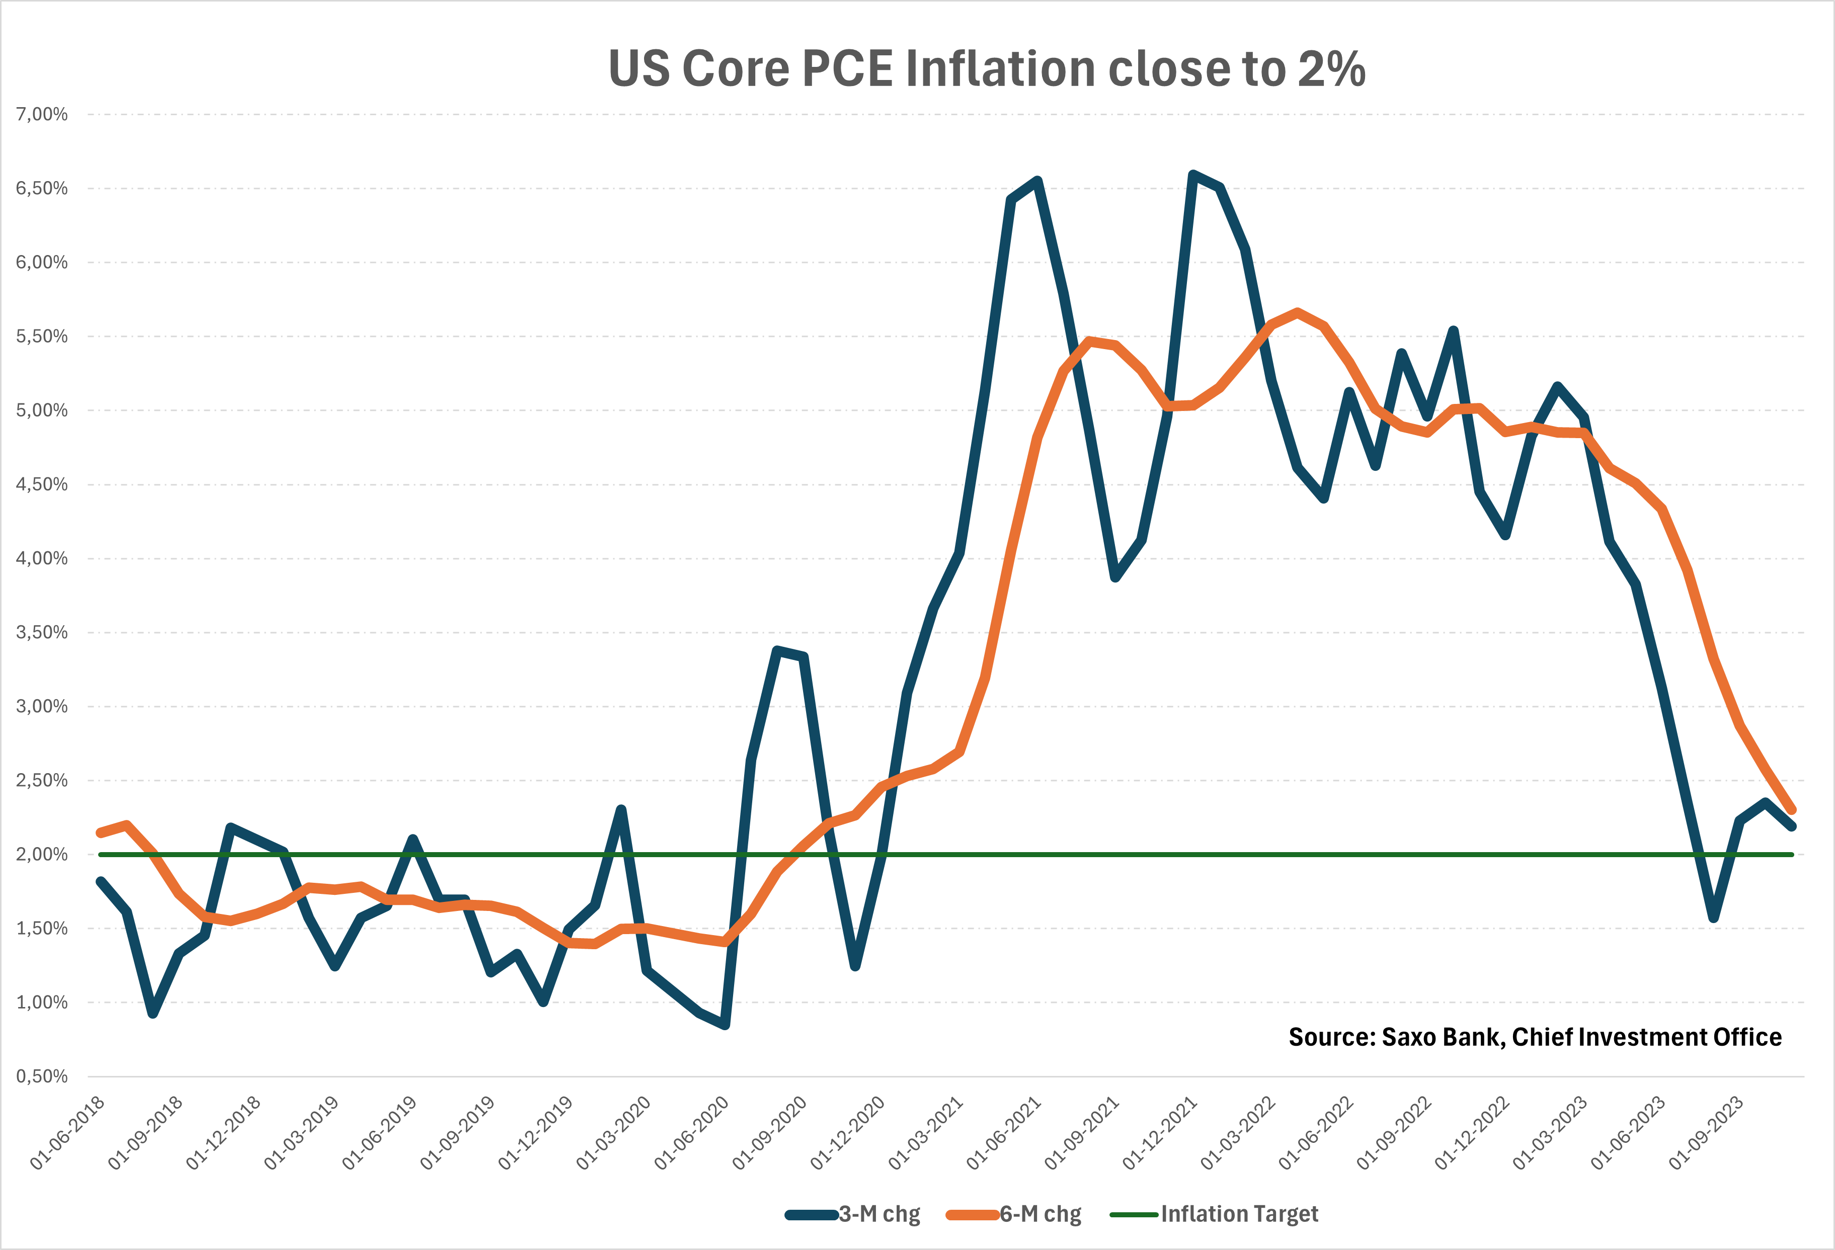
Disinflation: The Run rate on Core PCE < 2%

Slide 6
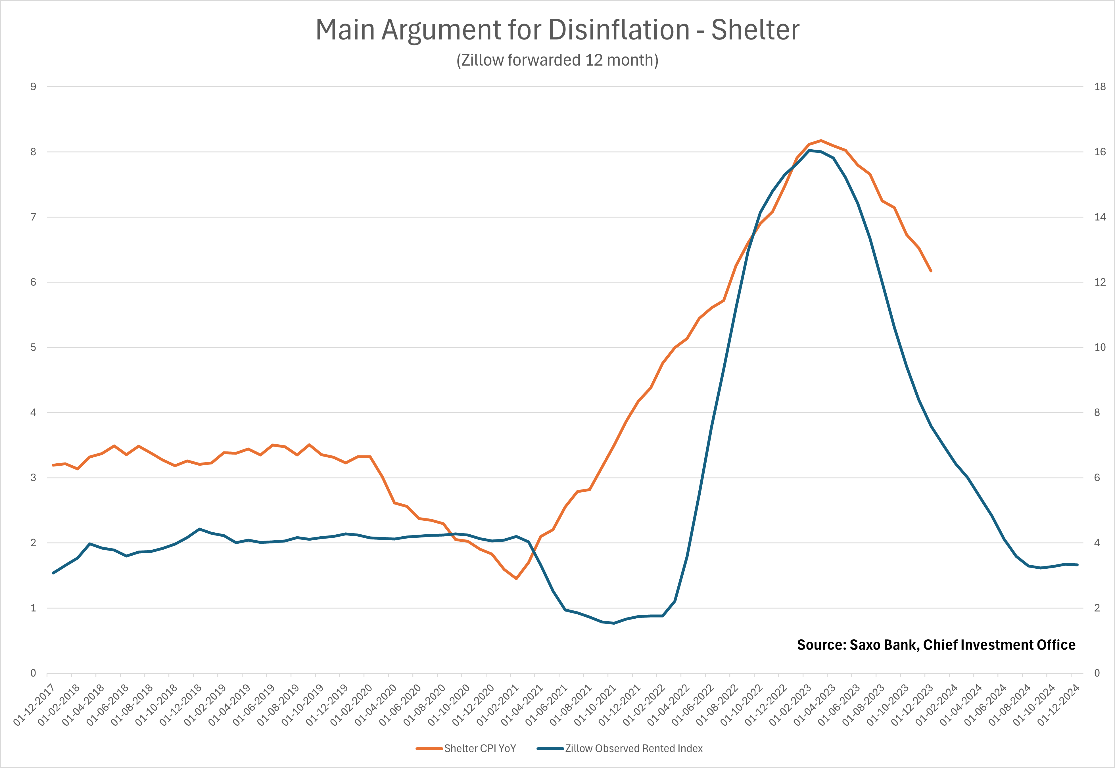
Disinflation: Shelter likely to continue down…

Slide 7
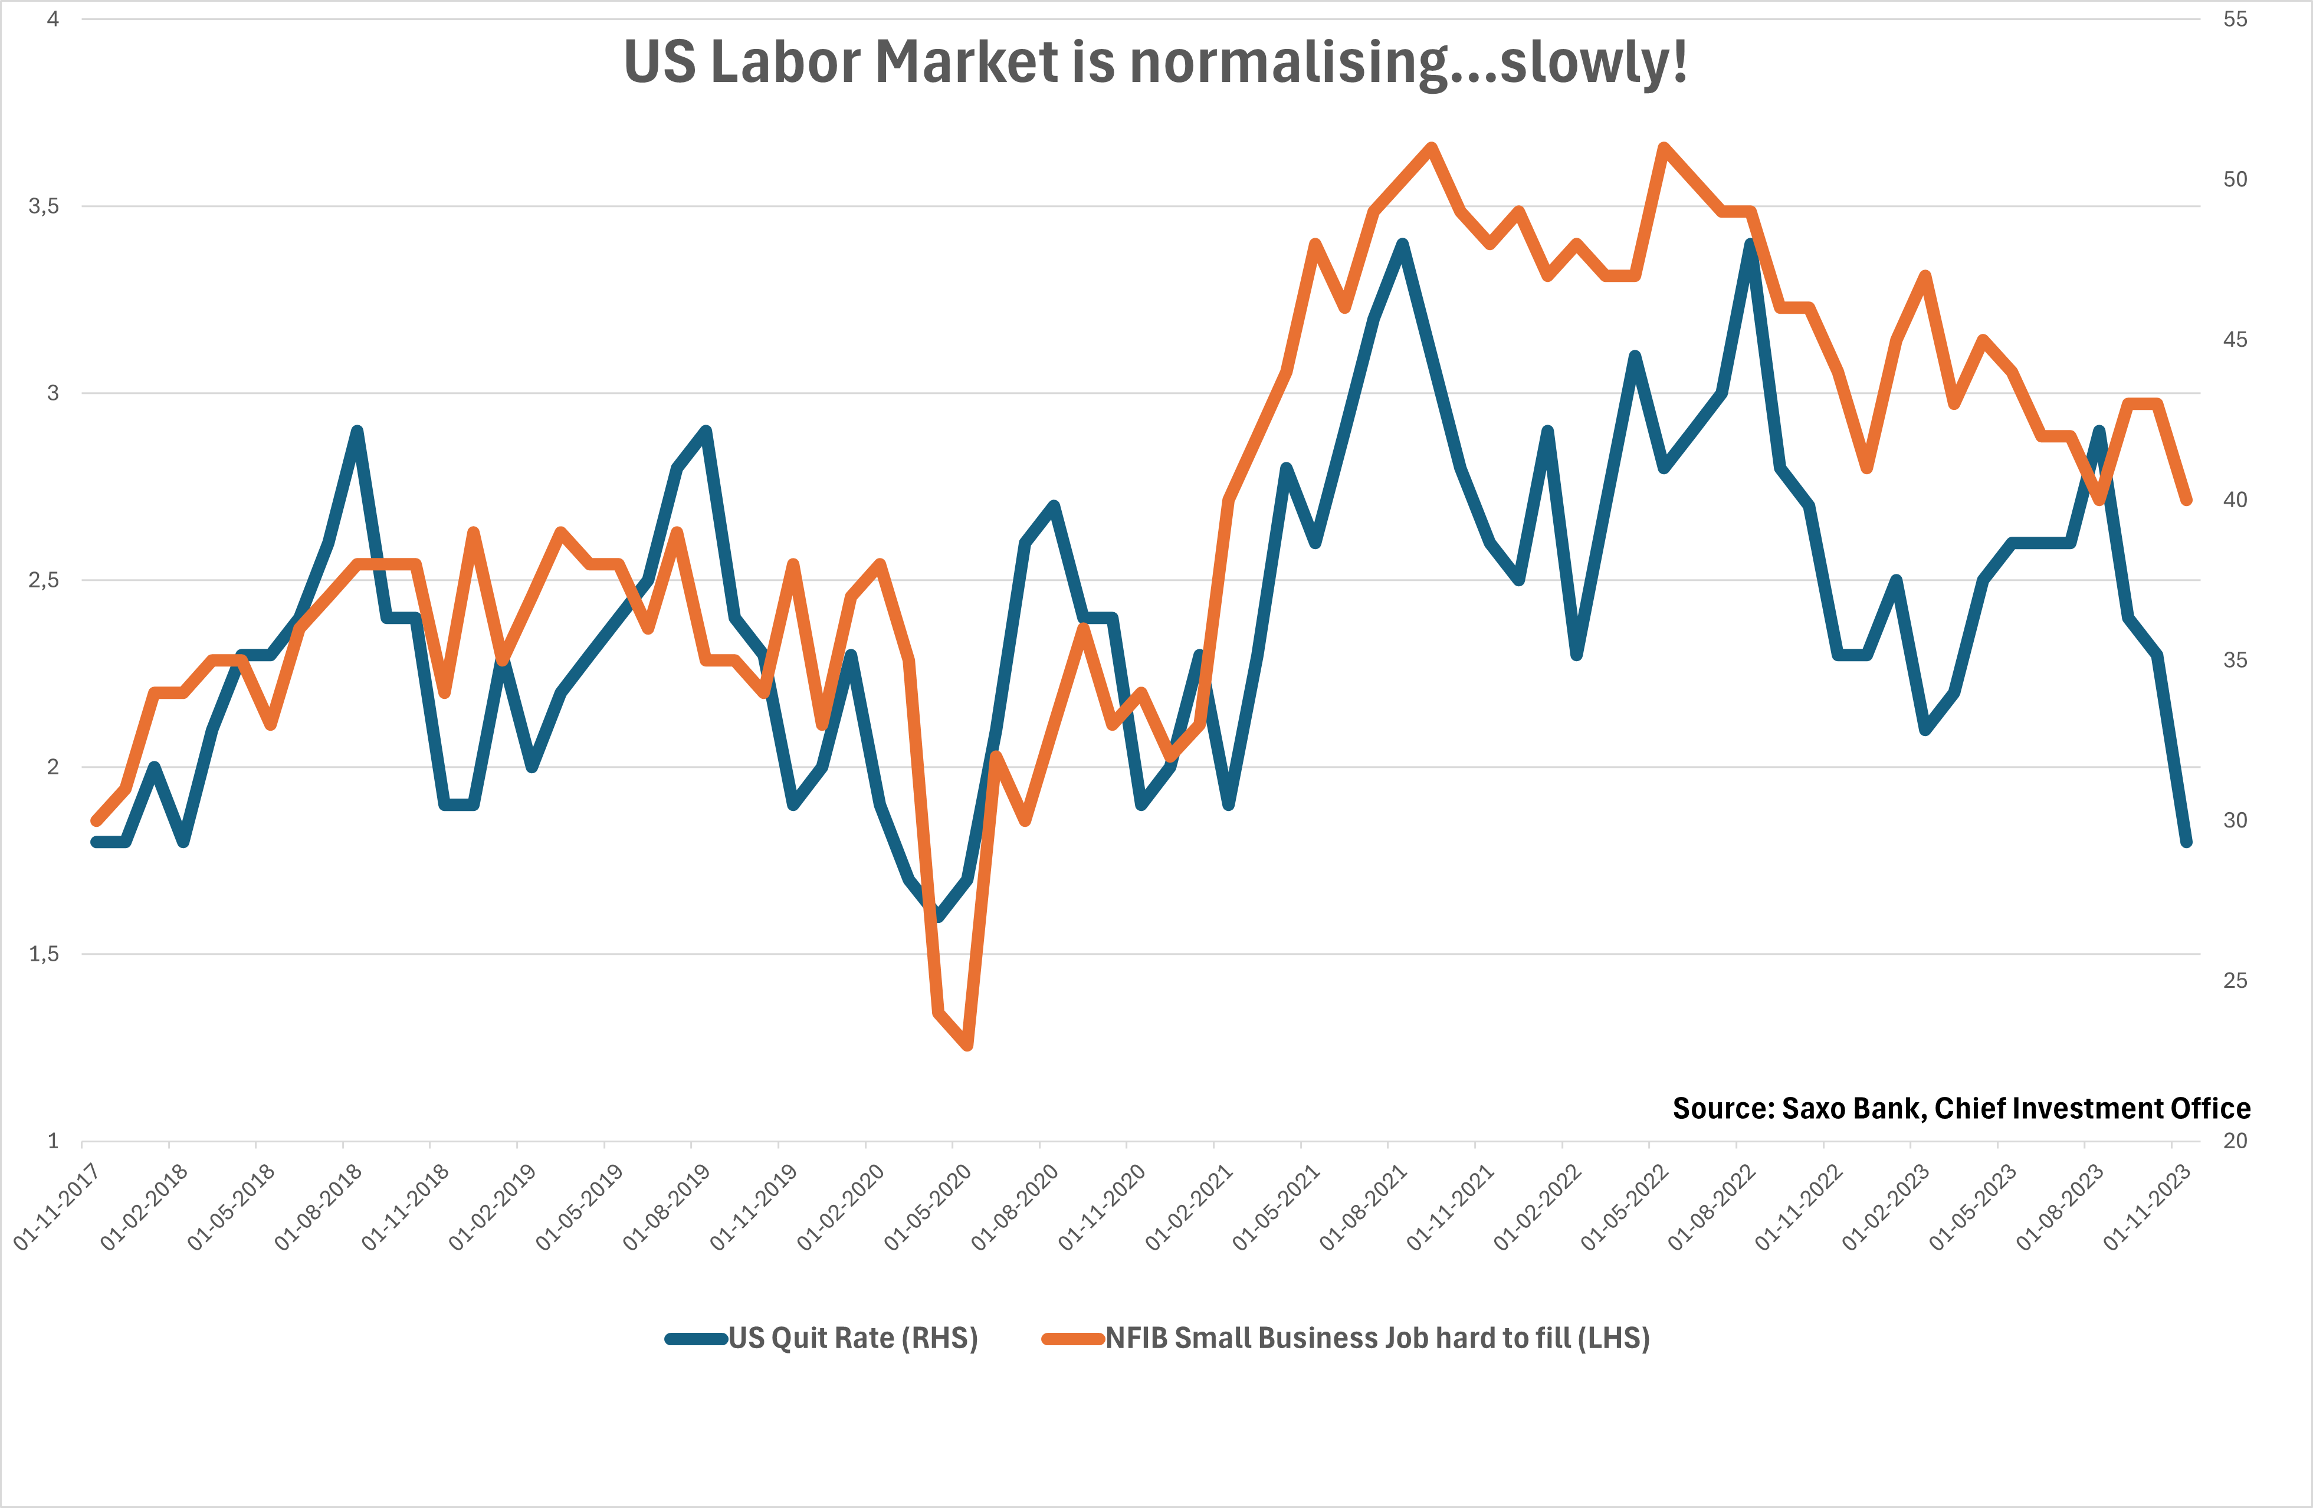
Disinflation: The H1 Impulse

Slide 8
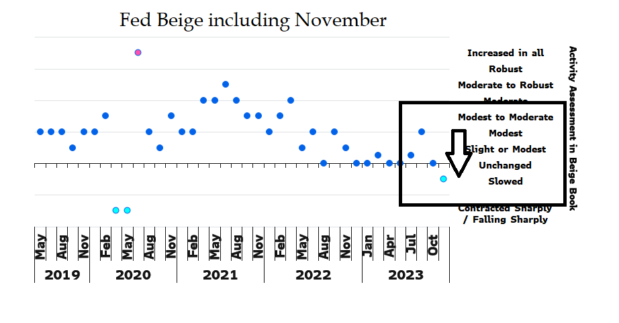
Fed don’t monitor same data as market, what do they see…?

Slide 9
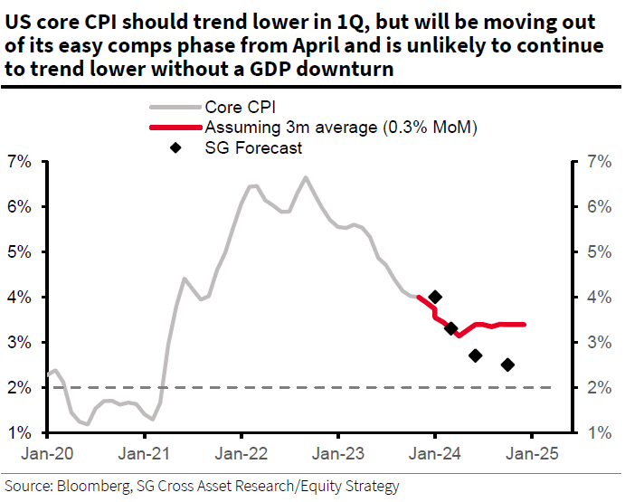
Q1-2024 likely to see “undershoot” on inflation

Slide 10
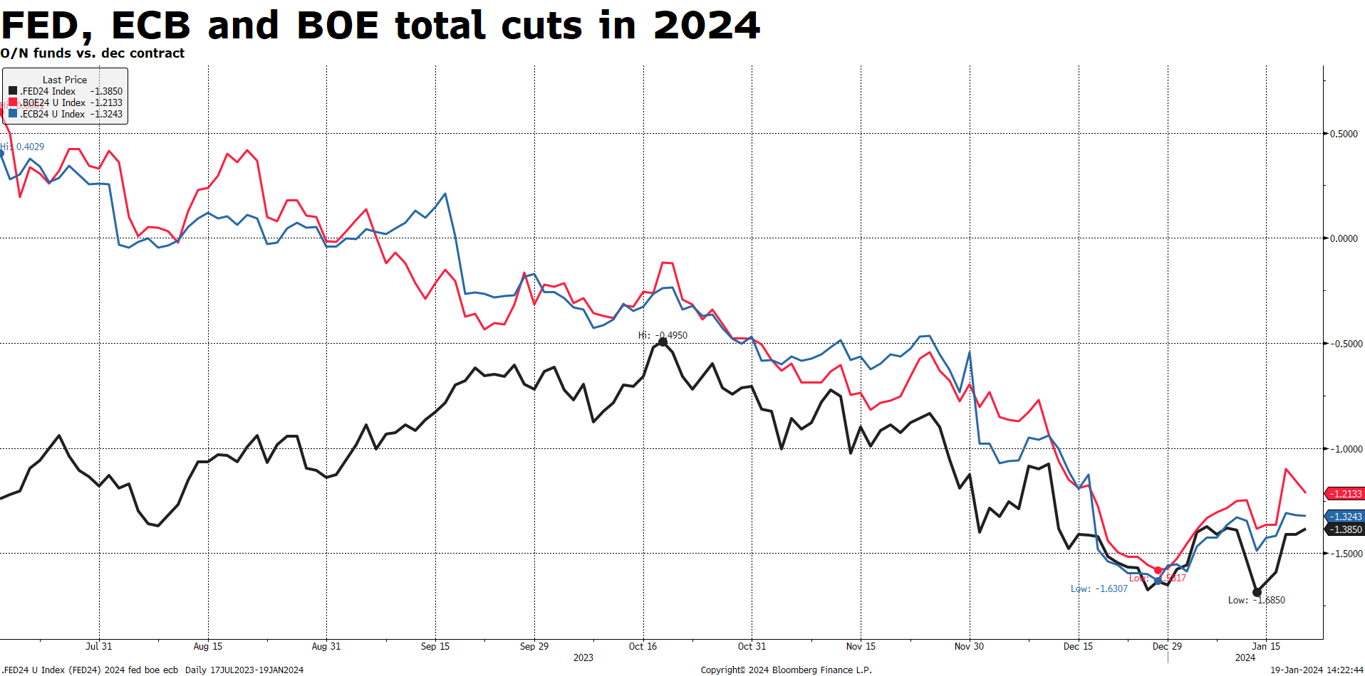
Major Central Banks aggressive cut in 2024

Slide 11
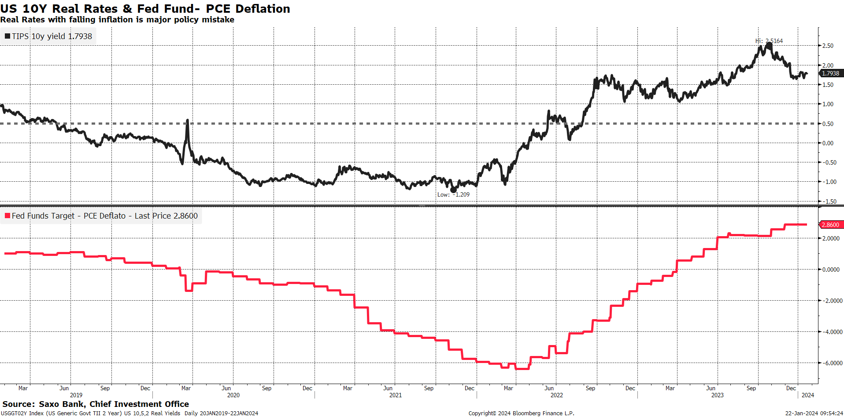
High Real Rates kills…..

Slide 12
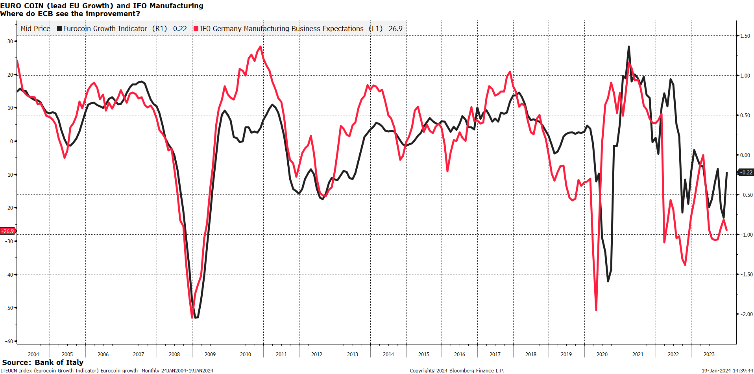
ECB Doing Major Policy Mistake
Waiting for Godot on wages…

Slide 13
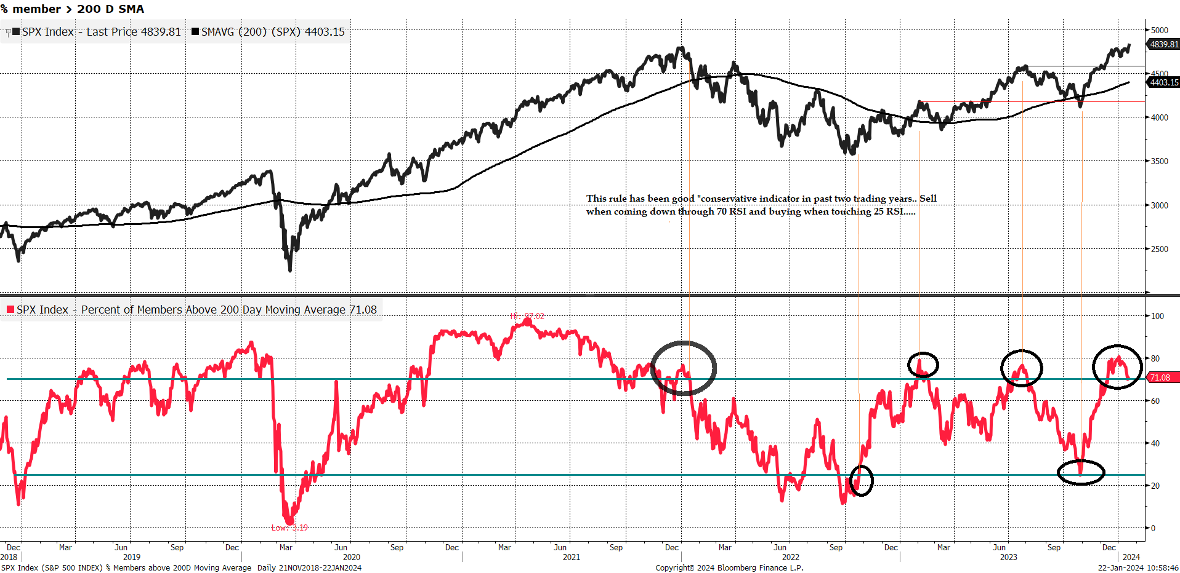
Is market expensive (for a reason ?) Probably ? Timing…

Slide 14
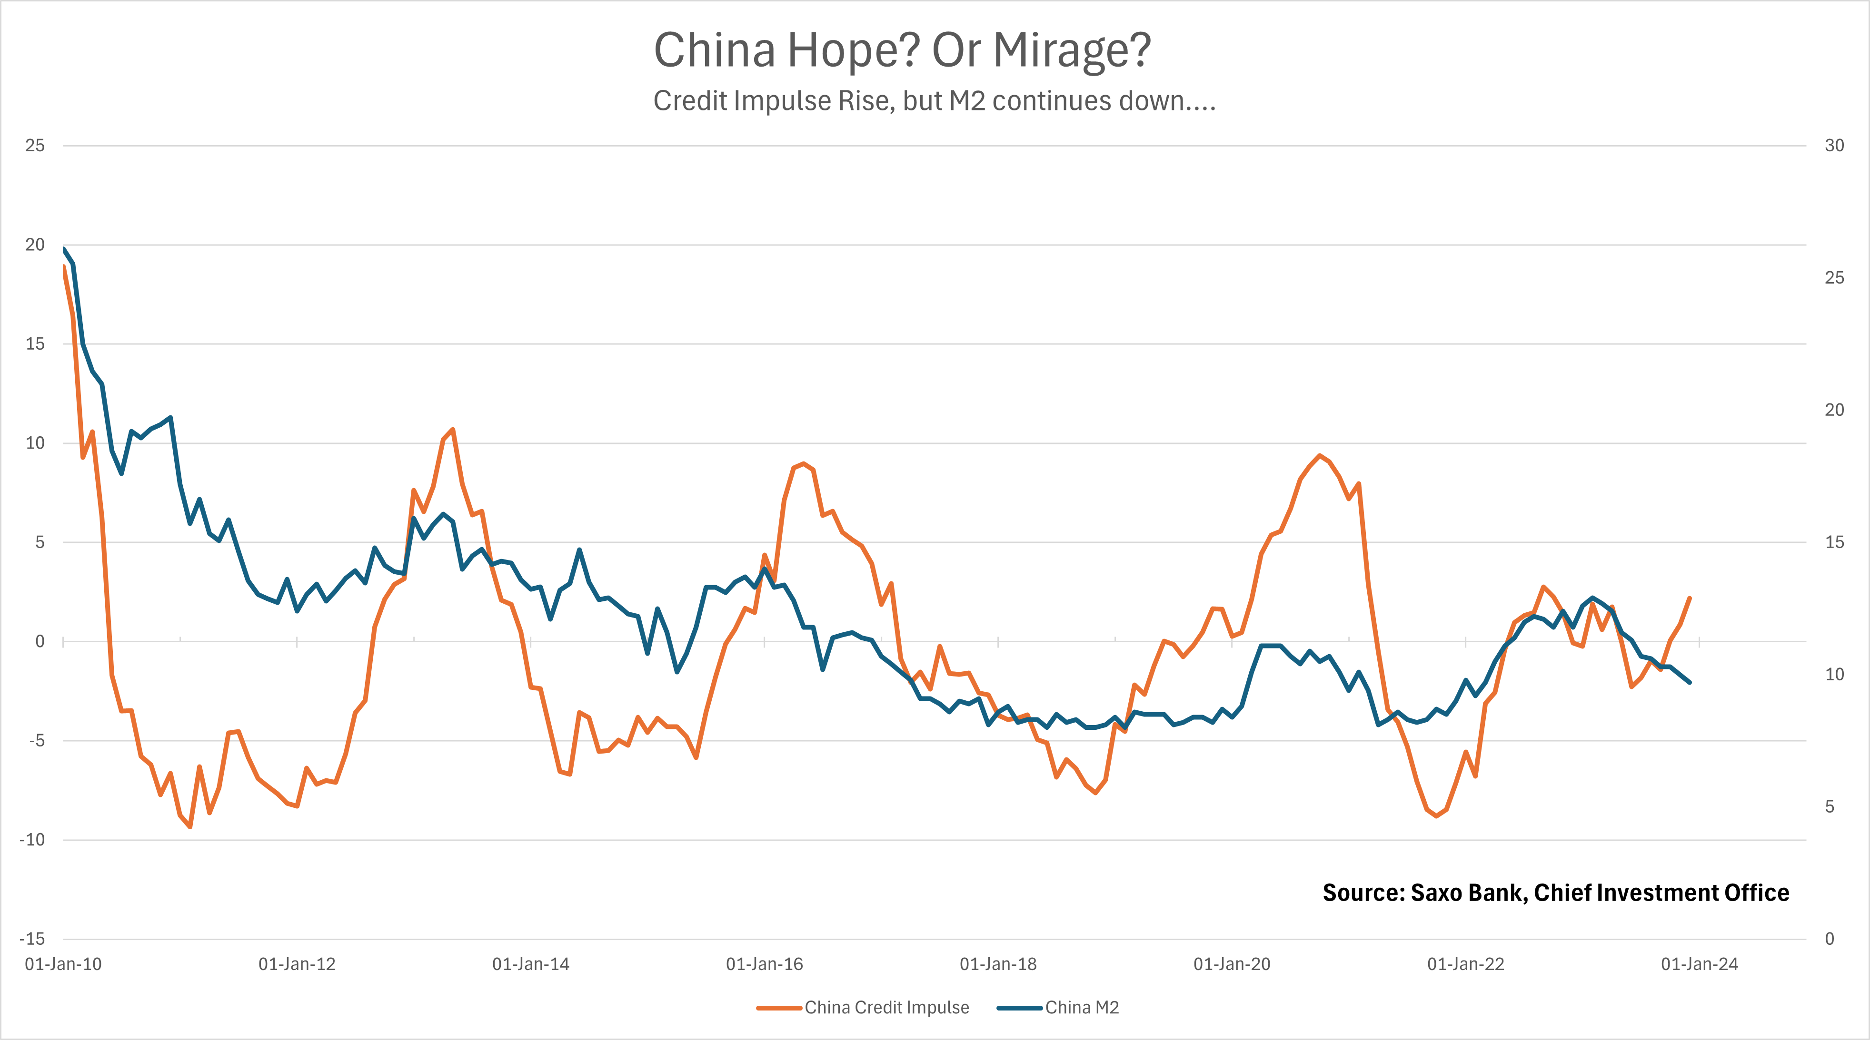
China – What’s next?

Slide 15
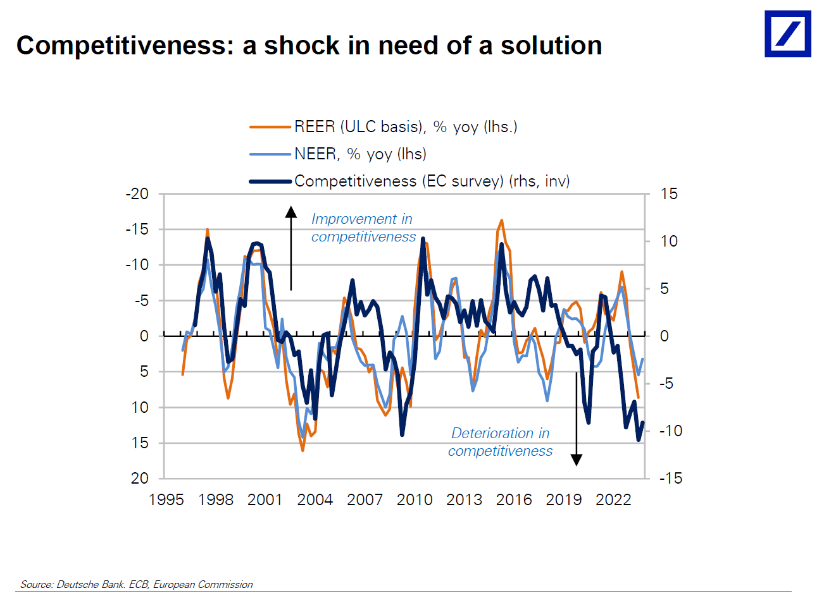
Europe needs to be more competitive – dramatic drop…

Slide 16
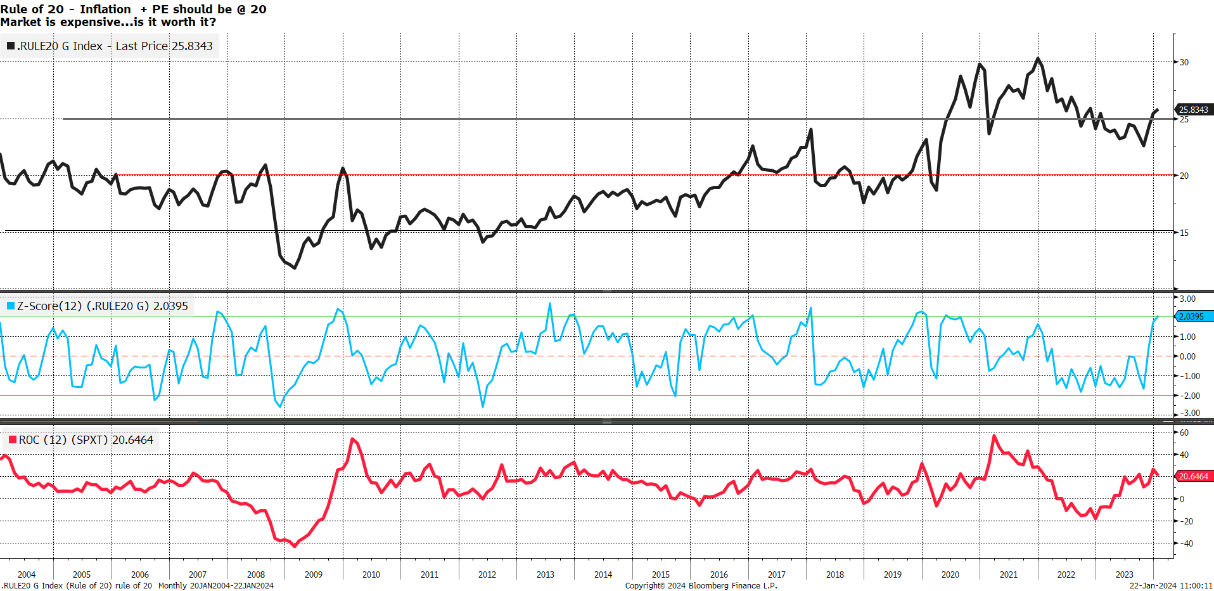
Is market expensive (for a reason ?) Probably ? Price

Slide 17
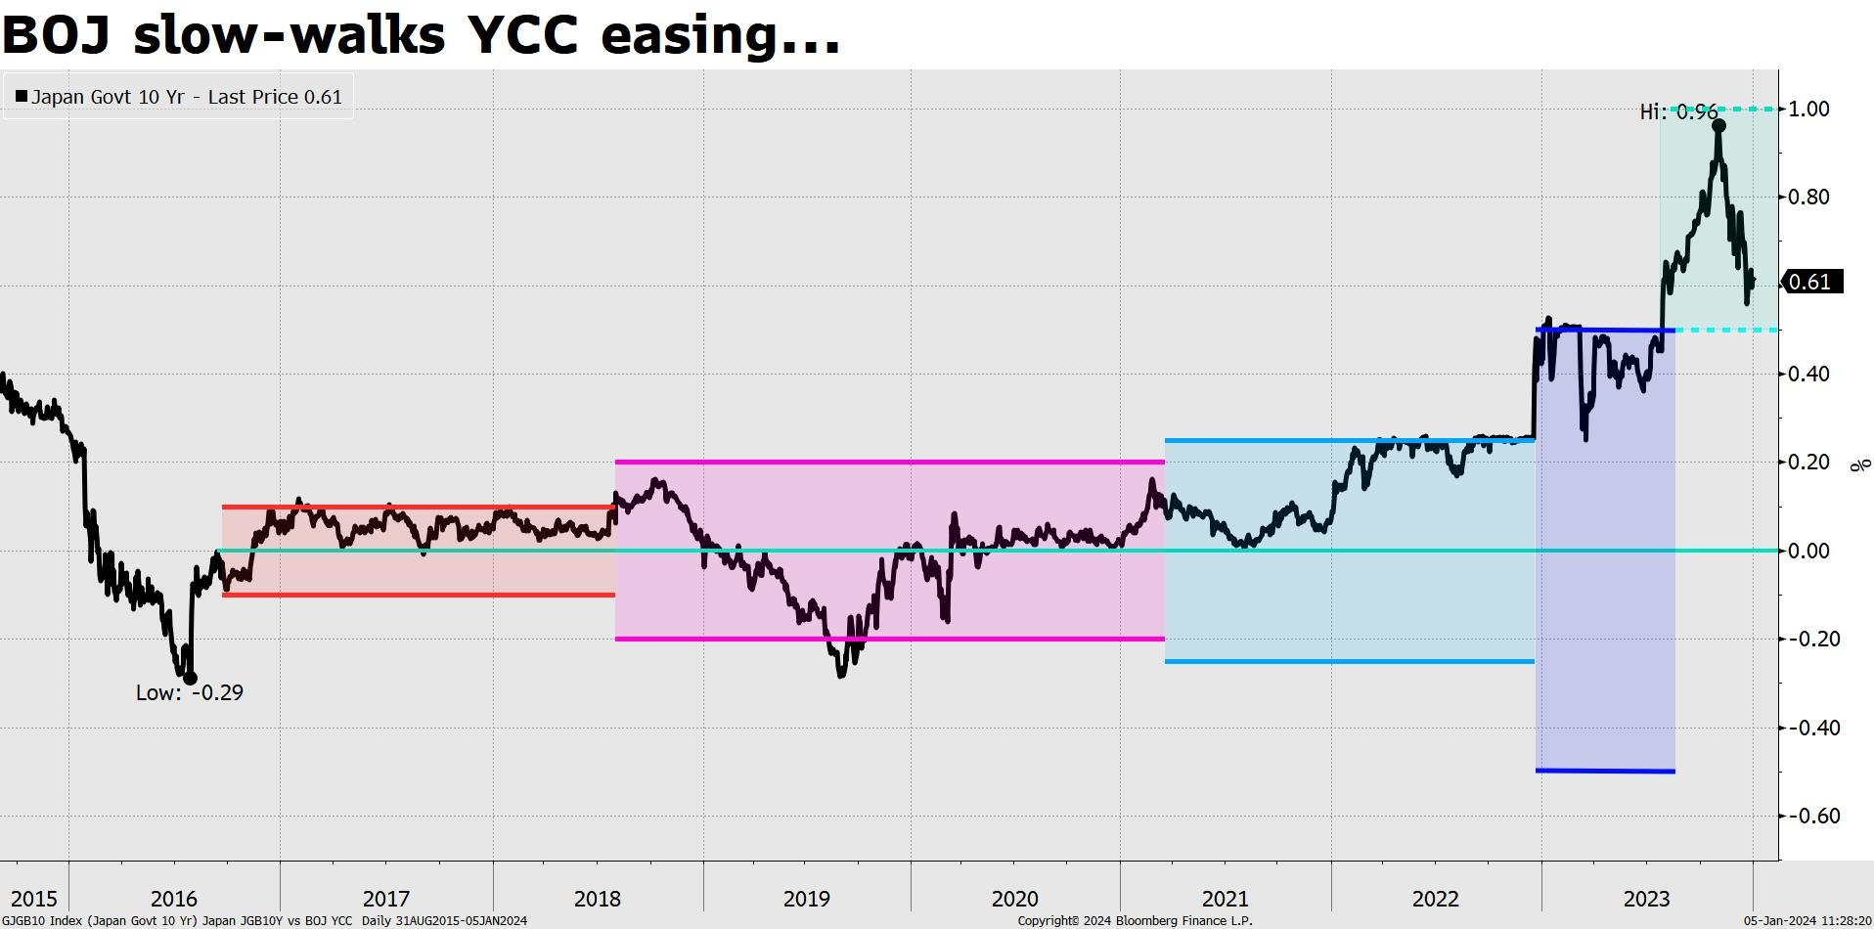
Japan & BOJ will have hard time setting higher rats…

Slide 18
2024 – Another inning of Pretend & Extend
The financial system is being "juiced" to give maximum support to incumbent political leaders.
The stock market is now really just a number. A game played live with big numbers. A modern-day Monopoly game. 5,000 why not 6,000 in S&p-500?
The Fed continues to indicate that if things get worse, they stand "on the ready." The Fed already seems engaged in changing direction with no economic vindication in November 2023. Why?
The Fed slow-down QT in a desperate move to support the market until November.
Real rates hit a new recent low below 100 basis points. Inflation picks up a little and rates fall a lot.
The US election cycle is confirmed in the upside on stocks:
The Potential Upside:
S&P 500 is up 20% and Nasdaq is up 35%
EMG does even better than S&P 500 with a 35% gain
Leveraged equity outperforms along with Russell 2000 and 3000 with 36% gains
Credit spreads fall close to zero. There is less risk in corporates than in governments!
The Potential Downside:
Recession comes hard and faster. (-25% to -30% downside)
Fed lose control with liquidity (Bank support program runs out in March)
China falls off a cliff (so does… Germany…) - (Global recession a la 2000 & 2008)
Escalation in Middle East….

Slide 19
Asset Allocation
Asset | Weight | Now
Fixed Income | 25% | 40%
Equity | 40% | 30%
Commodities | 20% | 20%
Crypto | 2% | 0%
Alternatives | 13% | 10%
FX – Overlay (vs $) | OW | Neutral
Total | 100% | 100%

Slide 20
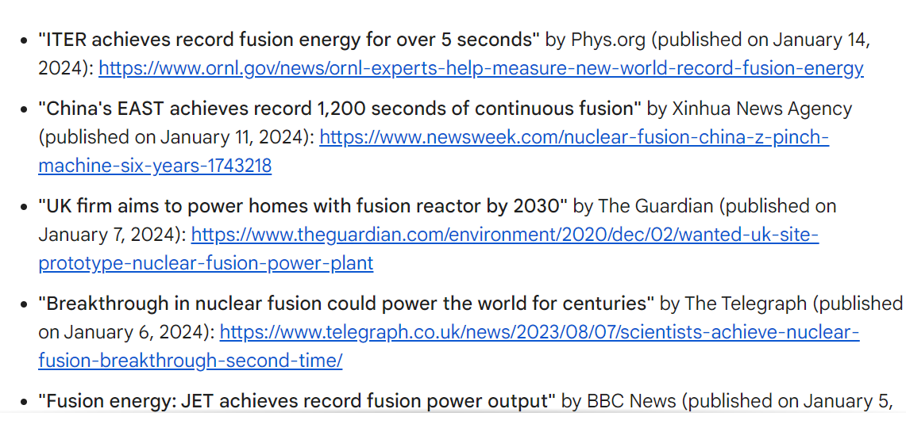
The Productivity Boom Coming – Fusion Headlines 2023
Marginal Cost of Energy @ zero by 2035?

Slide 21
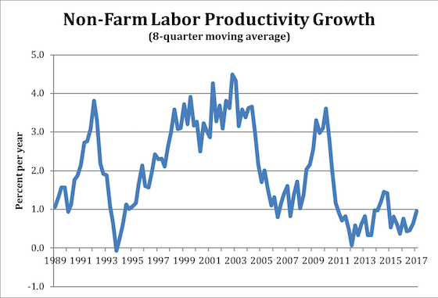
The Productivity Boom Coming
Ai impact on ROE
Year | Productivity | ROE | R-squared
1990 | 01.18 | 16.7 | 00.43
1991 | 01.25 | 13.2 | 00.38
1992 | 01.19 | 9.4 | 00.33
1993 | 01.17 | 6.2 | 00.30
1994 | 01.21 | 10.8 | 00.34
1995 | 01.24 | 14.4 | 00.37
1996 | 01.27 | 18.3 | 00.41
1997 | 01.30 | 22.7 | 00.45
1998 | 01.32 | 25.1 | 00.47
1999 | 01.34 | 33.3 | 00.51
2000 | 01.36 | 41.6 | 00.53
2001 | 01.36 | 23.1 | 00.49

Slide 22
Left Blank on purpose

Slide 23
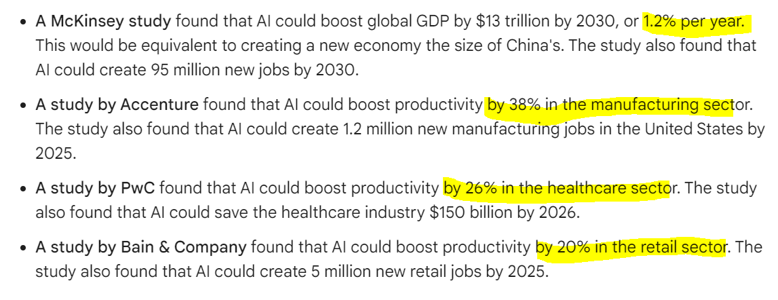
The Productivity Boom Coming
Ai impact on science - Fusion

Slide 24
The Productivity Boom Coming
Ai impact on science - Fusion
Point 1: AI-Powered Simulations for Enhanced Understanding of Fusion Physics
AI-powered simulations are providing unprecedented insights into the complex physics of fusion reactions. These simulations can accurately model the behavior of plasma, the hot, ionized gas that serves as the fusion fuel, and predict the effects of various parameters, such as magnetic fields and particle beams. This enables scientists to optimize fusion experiments and identify potential design improvements.
Point 2: AI-Driven Optimization for Efficient Fusion Reactor Operation
AI is being used to develop real-time control systems for fusion reactors, optimizing their operation to maximize energy production while minimizing plasma instabilities and disruptions. AI algorithms can analyze vast amounts of sensor data, identify patterns, and make informed decisions to adjust reactor parameters in real-time. This intelligent control is crucial for achieving sustained fusion reactions.
Point 3: AI-Assisted Design of Fusion Reactor Components
AI is revolutionizing the design of fusion reactor components, such as superconducting magnets and plasma-facing materials. AI algorithms can optimize the geometry and composition of these components to maximize their performance, reduce heat losses, and extend their lifespan. This optimization is essential for developing robust and efficient fusion reactors.
Conclusion
The integration of AI into fusion research and development has yielded significant progress in recent years. AI-powered simulations, AI-driven control systems, and AI-assisted design tools are paving the way for a more efficient, reliable, and cost-effective fusion energy future. As AI continues to advance, its impact on fusion energy is expected to grow even stronger, bringing us closer to achieving the dream of clean, abundant, and sustainable fusion power.

Slide 25
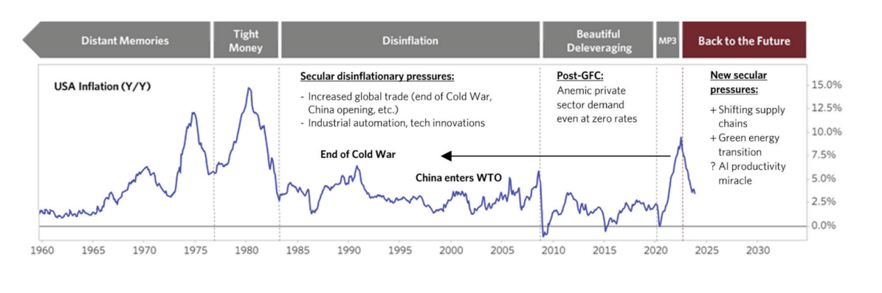
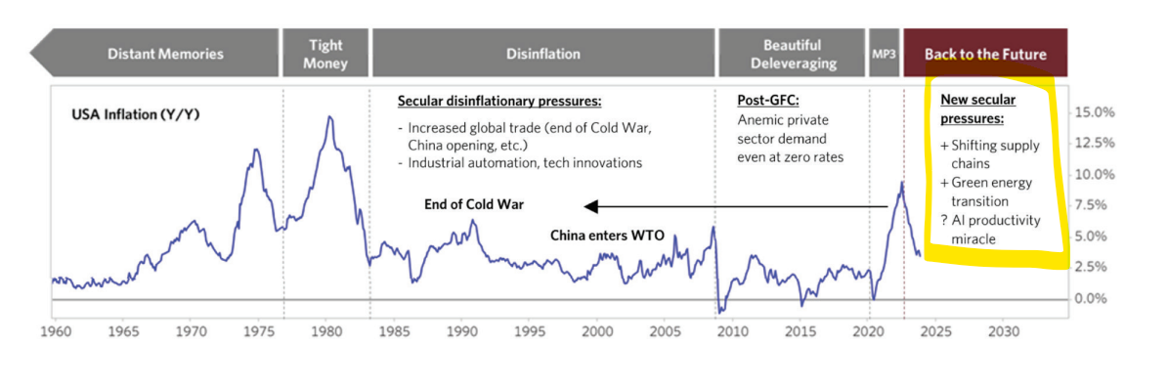
Back to the Future
Bridgewater Research

Slide 26
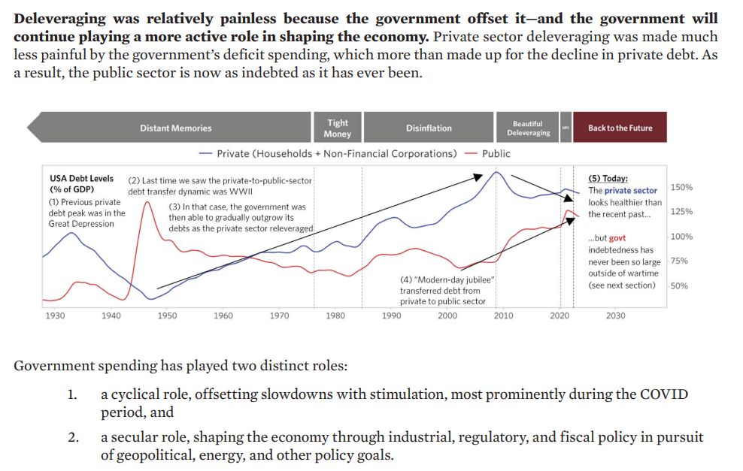
Back to the Future
Bridgewater Research

Slide 27
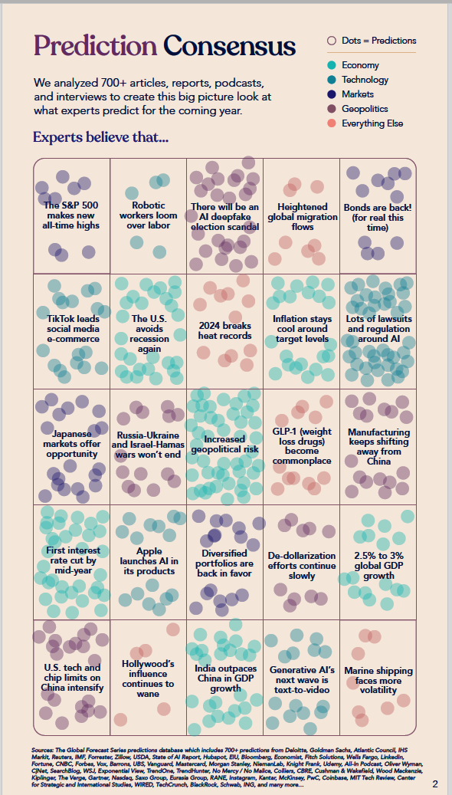
VisualCapitalist Survey of 700+ articles – the Consensus

