Slide 1
Technology Enablement.
Empowering People, Transforming Experience.
12 March 2025
SwissMBAs HR Leaders Summit
Max Eggenberger
Head of Business Development, Wipro Switzerland

Slide 2

Commodore 64 - Introduced 1982
The press predicted a revolution (with a different outcome)

Slide 3
Acknowledging the past - Predicting the future
Over the past ten years, our lives, industries, and workplaces have been redefined.
What lies ahead promises even more — more creative opportunities, less routine, and a future where technology and human potential intertwine.

Slide 4









Technologies that shaped the last decade
What has been the impact on humans?
Cybersecurity
Improved security without compromising usability
Artificial Intelligence & Machine Learning
Enhanced decision making, automation of tasks, improved personalized experiences
Augmented Reality & Virtual Reality
Immersive training & entertainment
Blockchain
Increased security & transparency in transactions
3D Printing
Greater personalization & innovation in product design
Internet of Things (IoT)
Connected devices; smarter homes & cities, increased convenience
5G Networks
Faster internet speeds, improved connectivity, remote work
Edge Computing
Faster decision-making in critical applications like autonomous driving
Biometric Authentication
Seamless security

Slide 5









Technologies likely to shape the next decade
How will the human experience transform?
6G Networks
Ultra-high-speed connectivity, enabling full XR immersion and telepresence
Brain-Computer Interfaces
Hands-free interactions, accessibility for disabled users
Digital Twins
Transparent, interactive models to simplify decisions in complex systems.
Synthetic Biology
Customizable health and environmental solutions, impacting everyday life and longevity
Hyper-Personalized AI
AI that learns and adapts to individuals in real time
Quantum Computing
Advanced problem-solving capabilities / More secure transfer of data
Fusion Energy
Potential for a cleaner energy future
Automated Autonomous Systems
Greater productivity & convenience
Holographic Displays
Enhances AR, entertainment & communication; high potential for education
AI-Driven Emotional Recognition
Improves context in human-tech interactions

Slide 6





Hot tech topics for HR professionals
#1 AI in Recruitment & Workforce Planning
#2 Hyper-Personalized Employee Experiences
#3 Filling the Tech Skills Gap
ISSUES TO KEEP IN MIND…
#4 Wellbeing in the World of Hybrid Working
#5 Transition to AI-Augmented Working
#6 Virtual Onboarding & Training
AI ethics and bias
Privacy and autonomy
Data security
Barriers to technology adoption
Changing legal landscape e.g. EU AI Act
#7 Data-Driven Diversity, Equity, & Inclusion
#8 Ethical Challenges of HR Automation
#9 AI-Powered Career Management Platforms

Slide 7
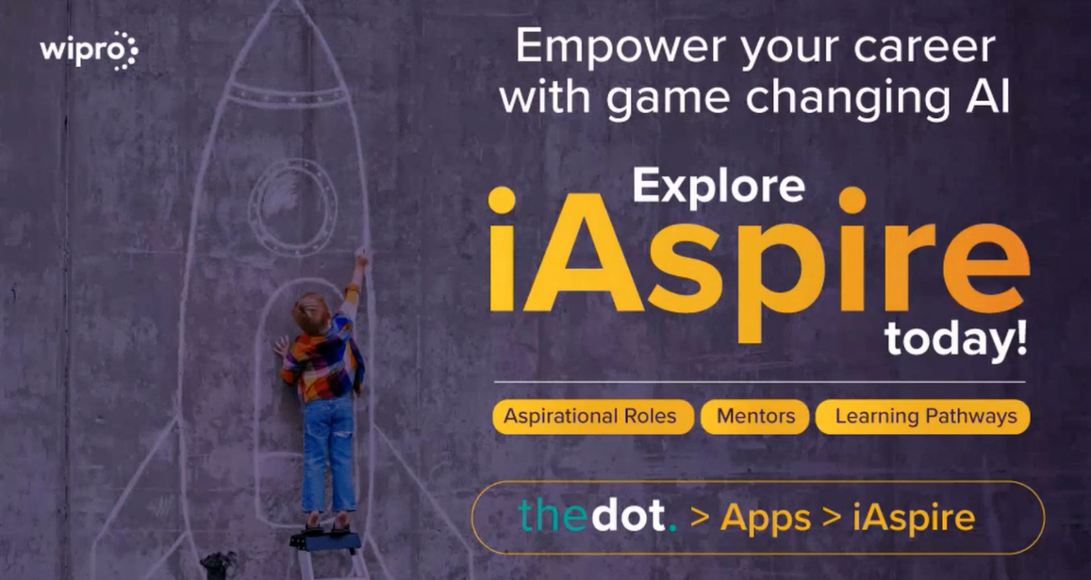

Slide 8





iAspire: Technology to empower employees
Offers personalized and on-demand learning recommendations based on an employee`s aspirations
Provides suggestions for career paths that match an employee`s aspirations
Builds and expands an employee`s network of peers, experts, and mentors
Creates skill assessment & development plans to future-proof an employee`s career
Connects employees with job openings that match their current skills

Slide 9

iAspire: Creating a future-ready workforce
Adoption rates: 199.5K of our associates (> 85% of Wipro) have created their profiles on iAspire.
Career aspirations: 55% of the associates have called out career Aspirations on the platform.
Learning opportunities: Over 3,200 courses available - (from Harvard Manage Mentor, HBR Spark, Wipro’s Internal LMS).
Jobs: All internal opportunities across Wipro are available on iAspire.
Workforce planning: Wipro’s Resource Management team uses iAspire’s AI-based search & match engine to propose the right talent for the right opportunity.

Slide 10
We are at an exceptional moment in history.
Technology is relieving us from repetitive tasks, unlocking creative roles, and enabling a richer, more innovative future.
But it’s also a journey where we don’t have all the answers - and that’s okay.
A Turning Point

Slide 11
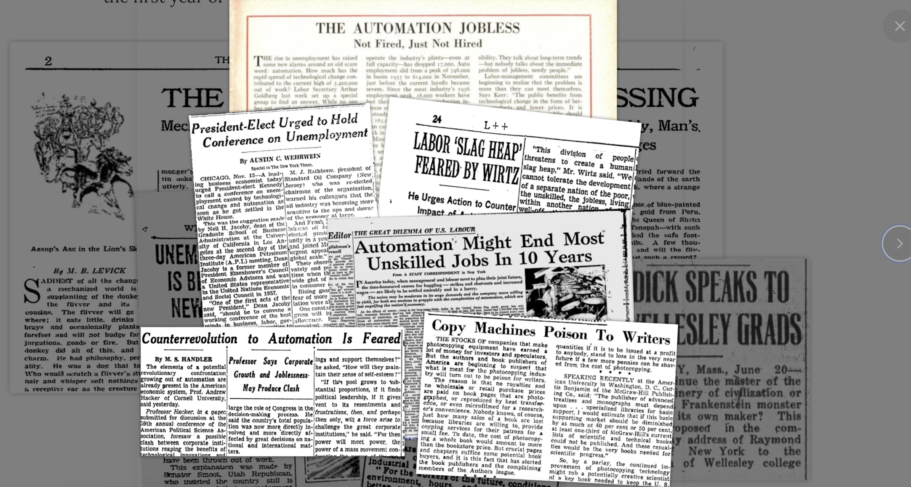
Support our colleagues in embracing new capabilities

Slide 12

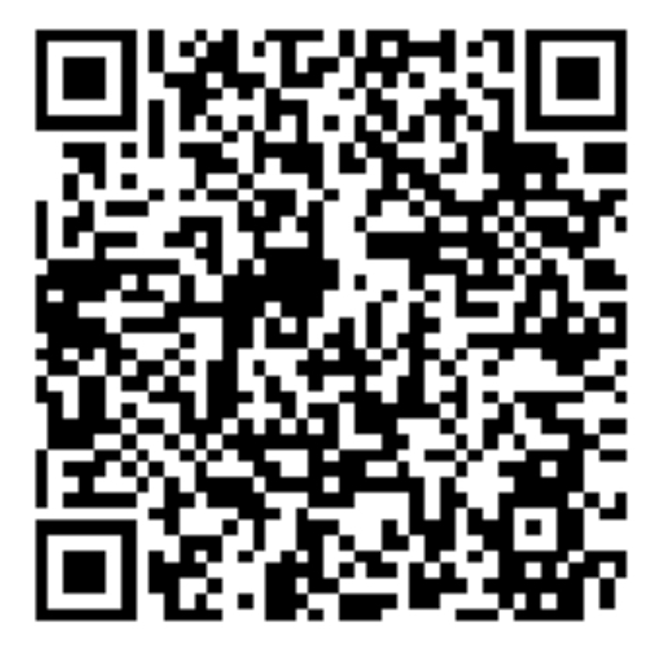

Thank you.
Technology Enablement.
Empowering People,
Transforming Experience.
Max Eggenberger,
Head of Business Development
Wipro Switzerland
12

