Slide 1
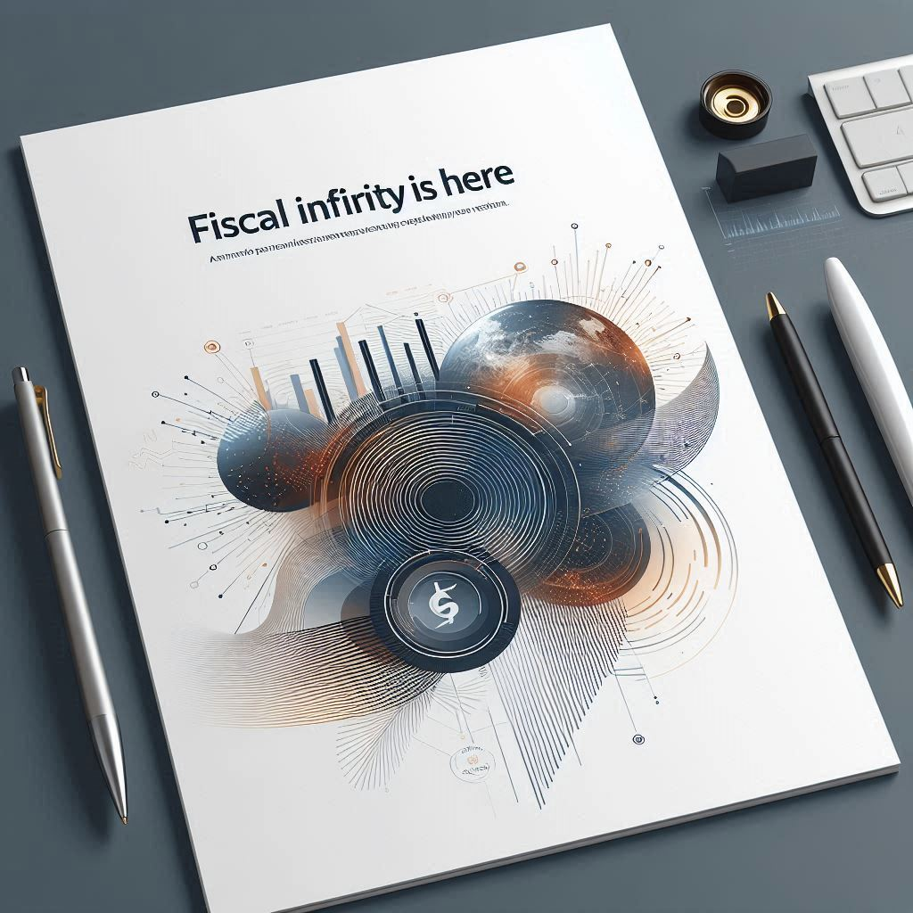
CFA Society, Switzerland, May, 2025

Slide 2
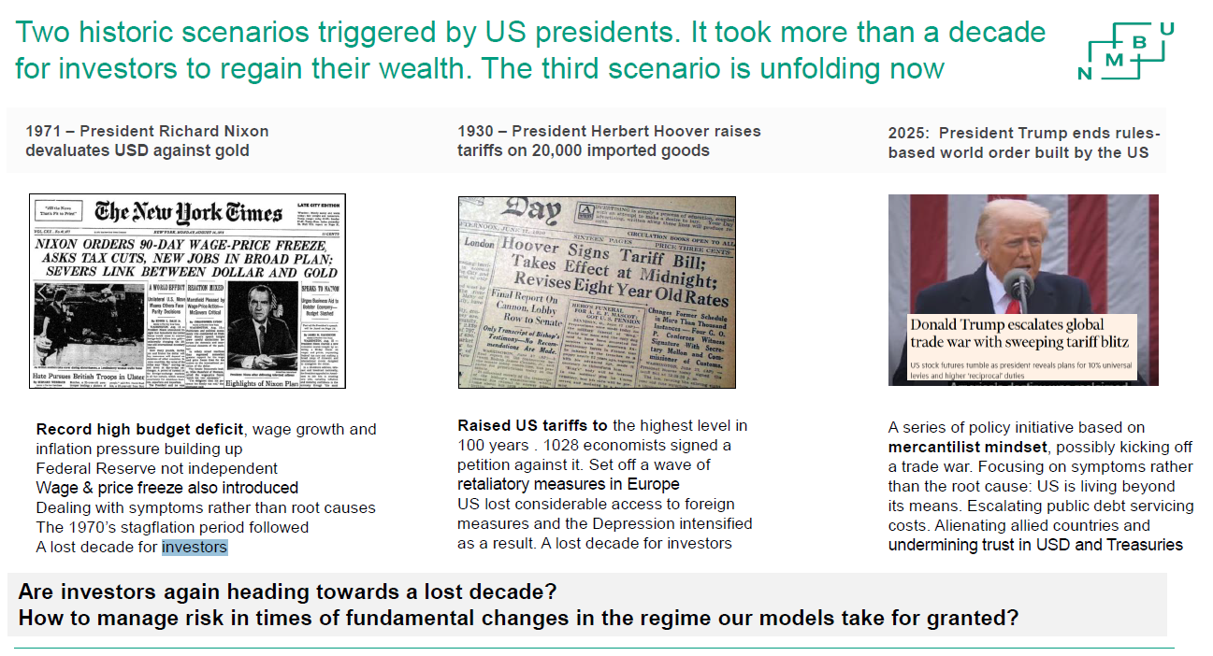
Self-inflicted Policy = Lost decade?

Slide 3
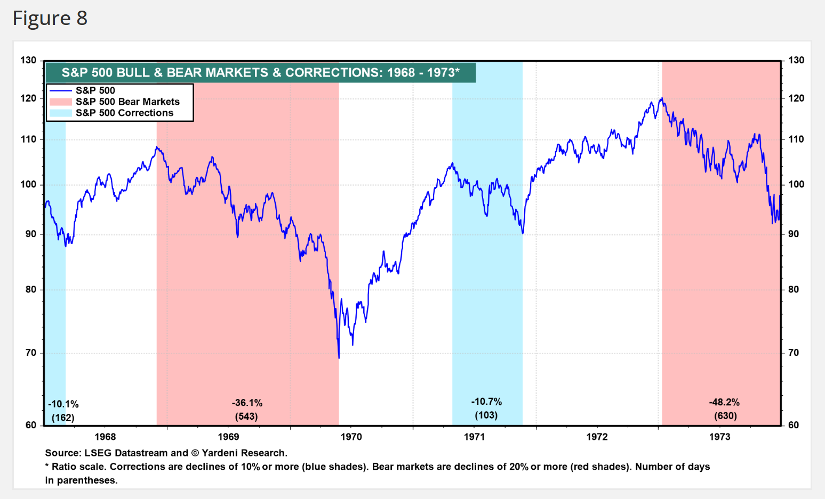

Slide 4
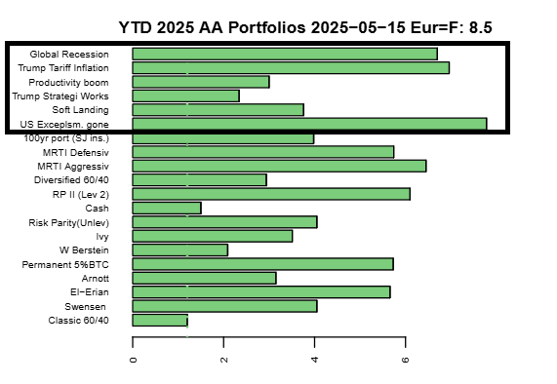
YTD: The winner is: US Exceptionalism Gone

Slide 5
Europe’s Strategic Policy Shifts Since Trump’s Return (2025)
Policy Area | New European Policy | Trigger from U.S. Policy
Scientific Research | €500M EU “super grant” program; France’s “Choose France for Science” initiative | U.S. science funding cuts, DEI restrictions
Defense & Security | €800B EU “Readiness 2030”; Macron offers nuclear umbrella | U.S. NATO disengagement, Ukraine pullback
Diplomatic Alliances | Formation of “Weimar+” coordination bloc | Exclusion from U.S.-Russia Ukraine talks
Trade & Tariffs | New trade deals with India, Mercosur | U.S. tariffs on EU cars and steel
Immigration & Mobility | Surge in U.S.-to-EU visa demand, UK passport applications | Instability and academic restrictions in U.S.

Slide 6
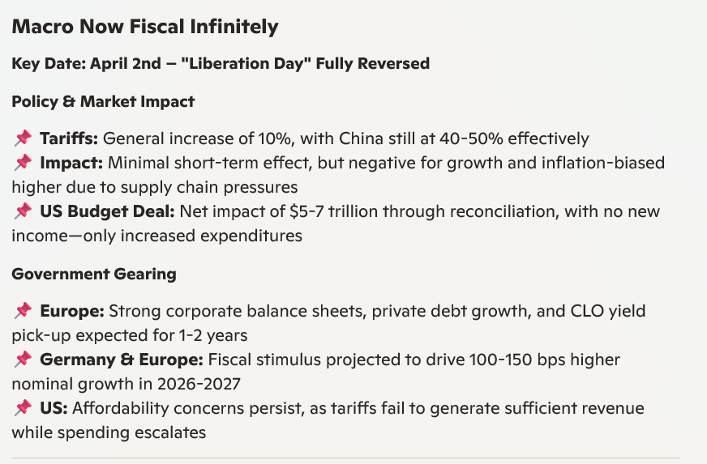

Slide 7
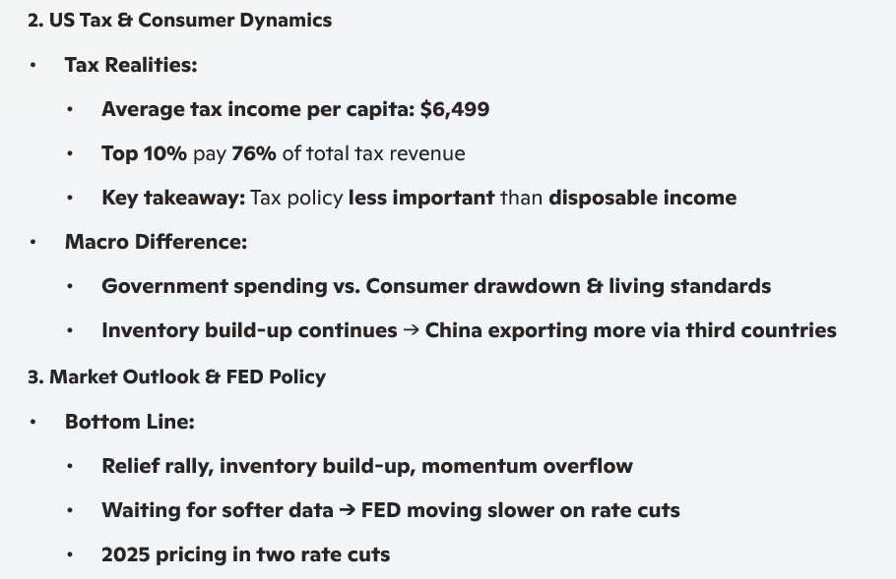

Slide 8
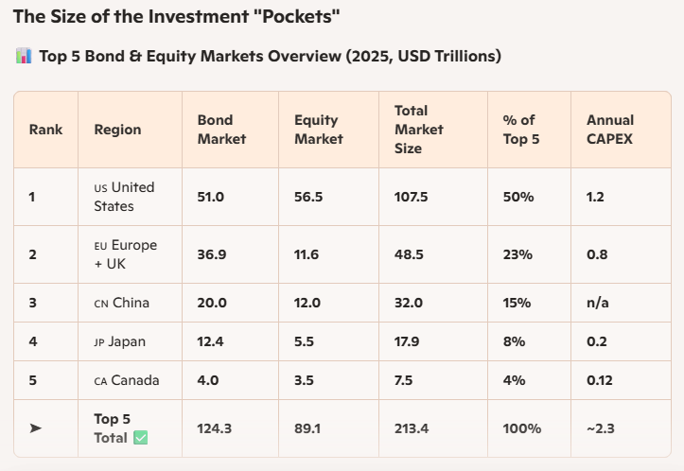
If TINA turns into TIAA?

Slide 9
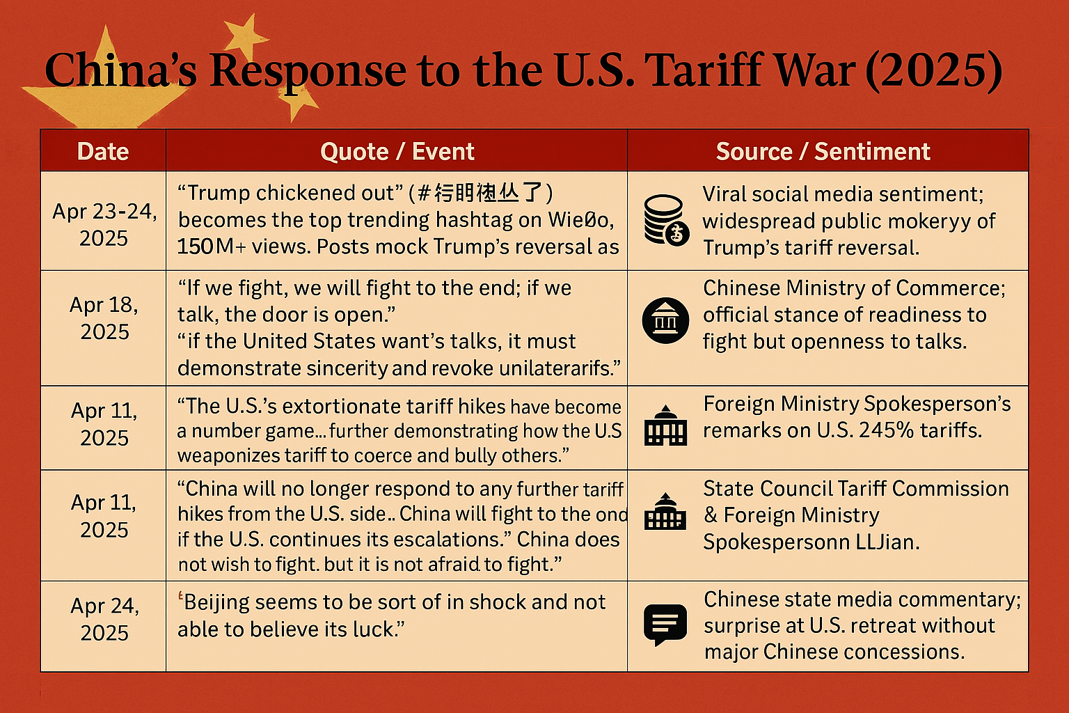
China preparing population for..... Taiwan?

Slide 10
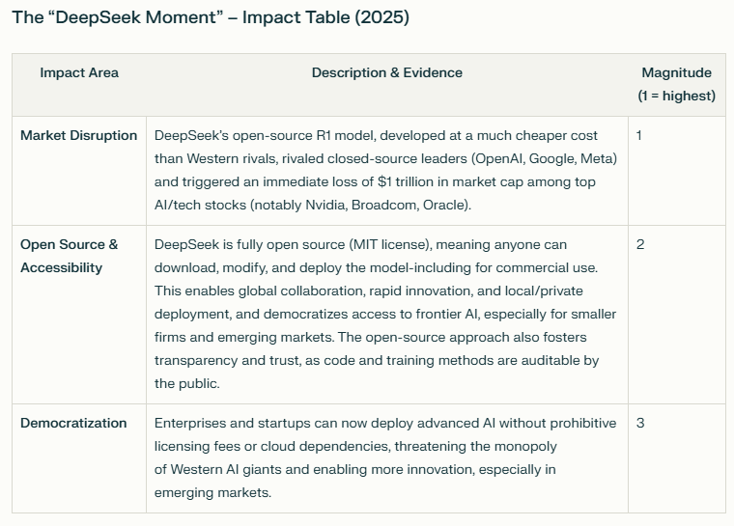

China vs. America

Slide 11
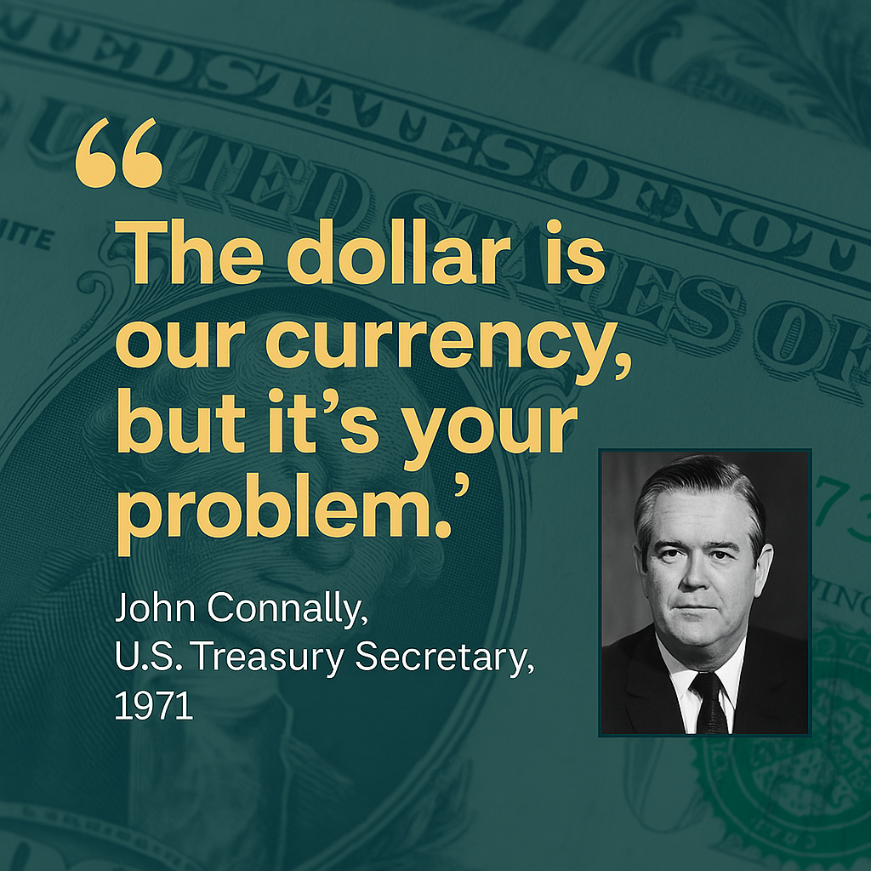
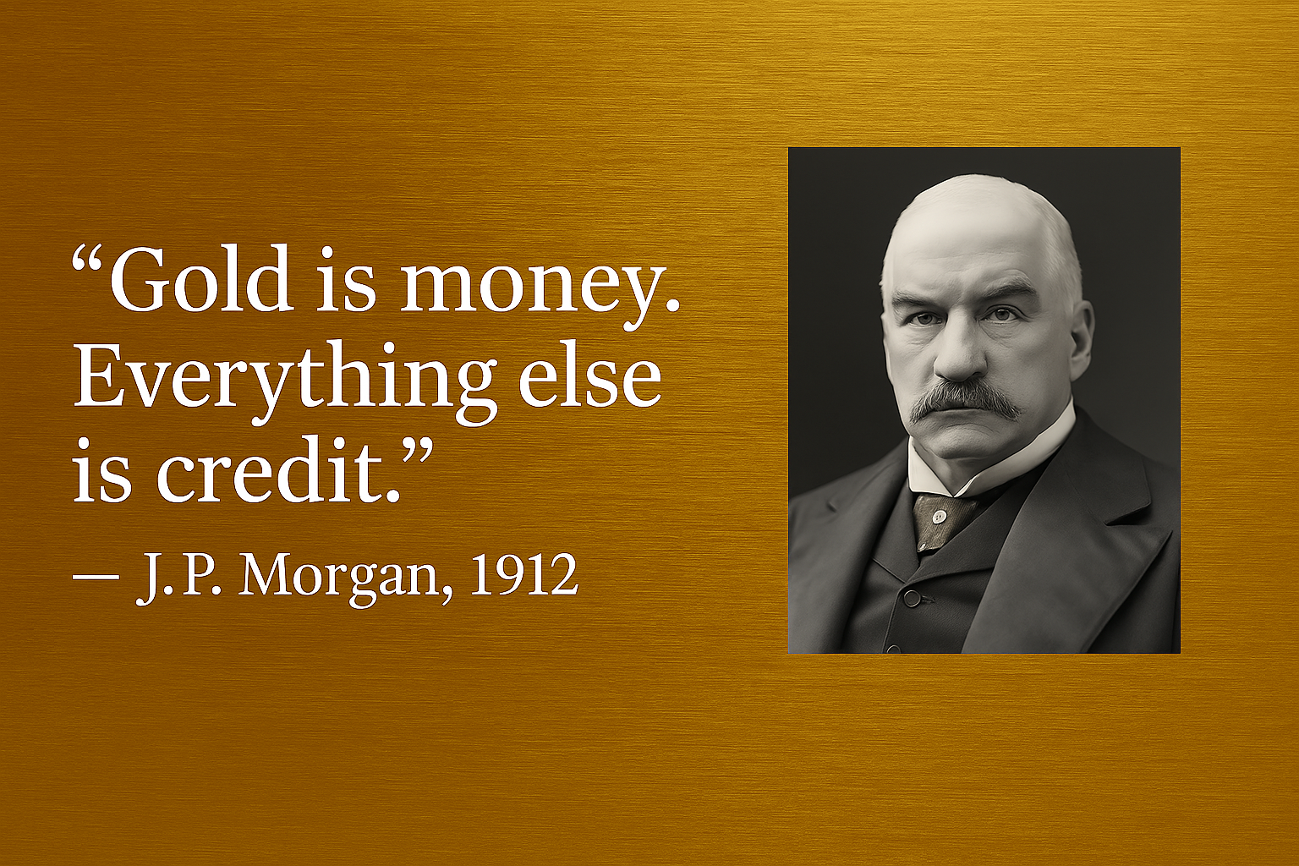
Do you measure your wealth in $ or Gold?

Slide 12
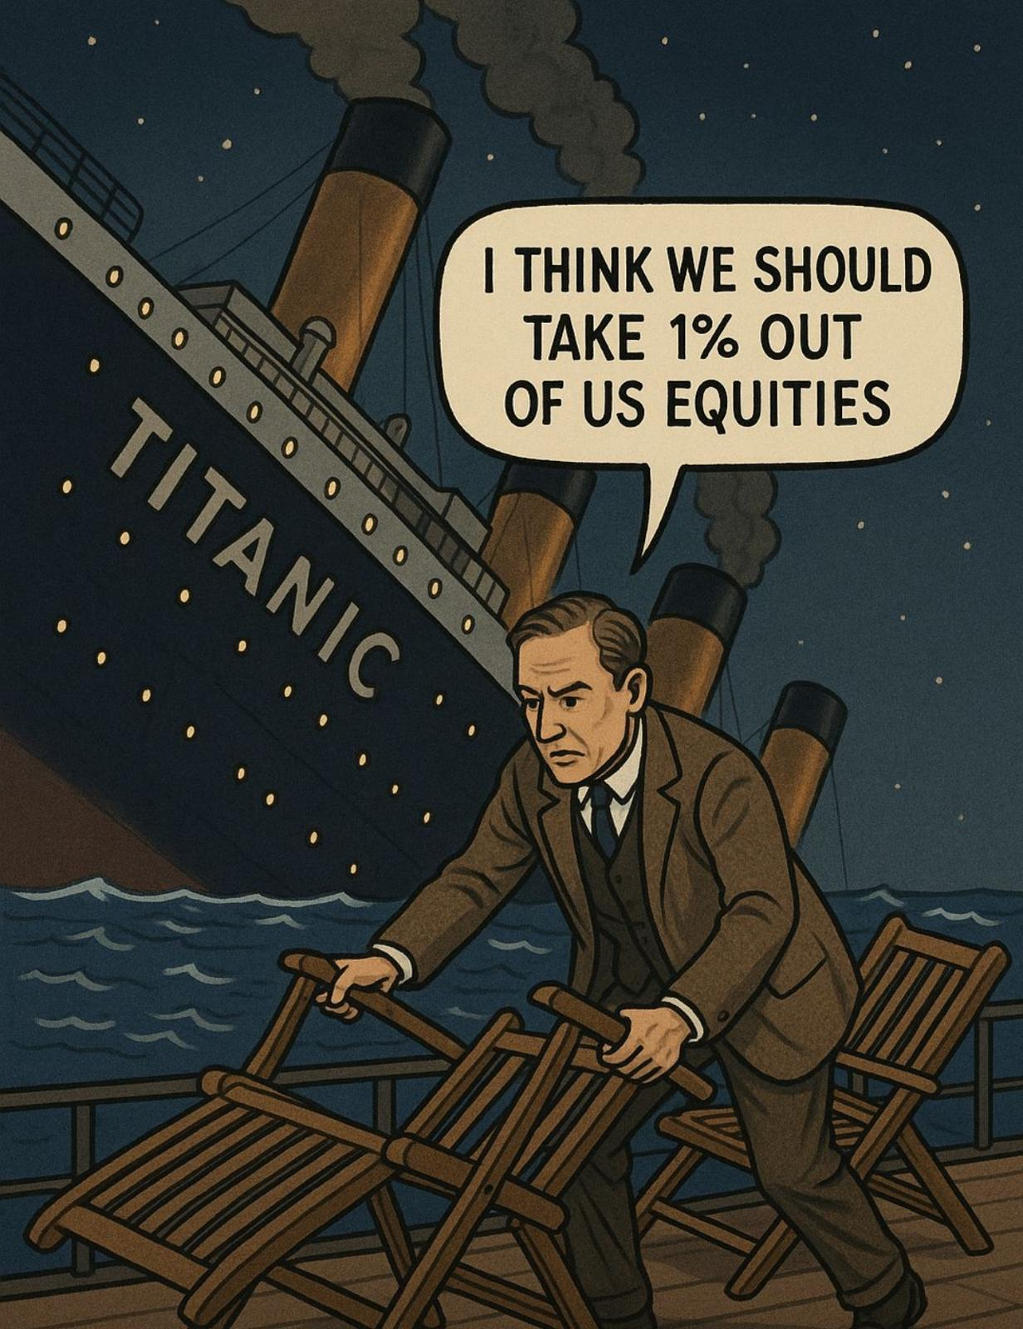

Once in a Lifetime Change? Dont miss it!

Slide 13
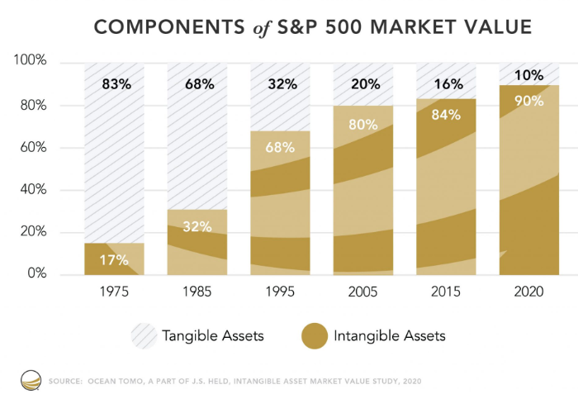
The Real Strutural Change Needed

Slide 14
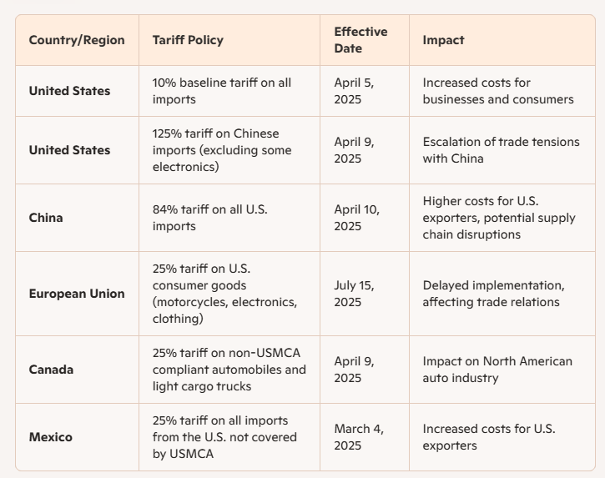
China vs. America

